Slide 1
Advanced Simulations
Here is where your presentation begins

Slide 2
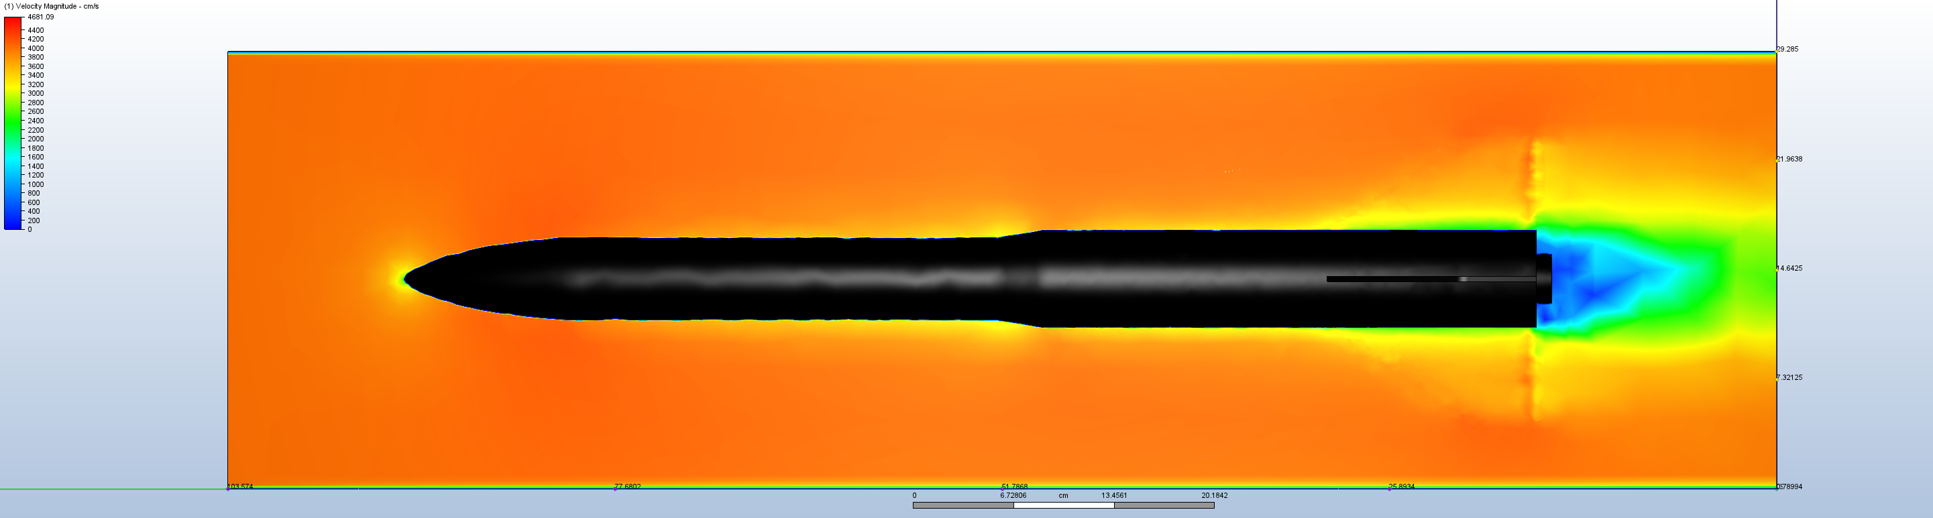
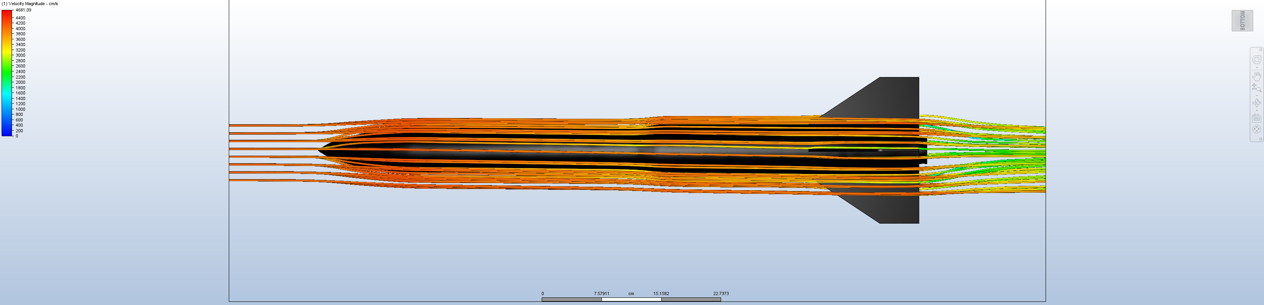
Computational Fluid Dynamics

Slide 3
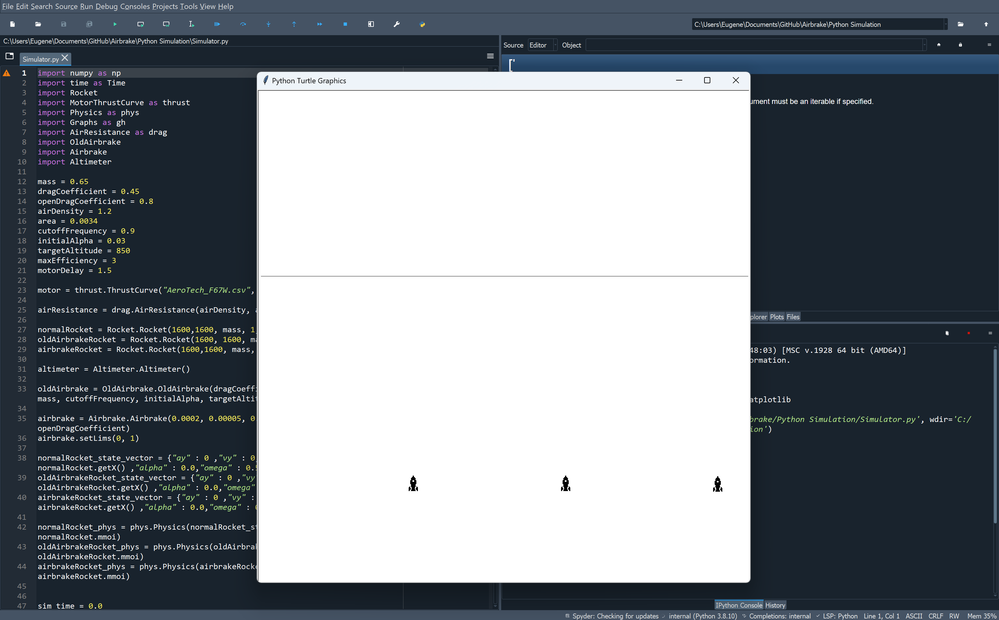
Python Simulations

Slide 4
03
Clinical trial
You can enter a subtitle here if you need it

Slide 5
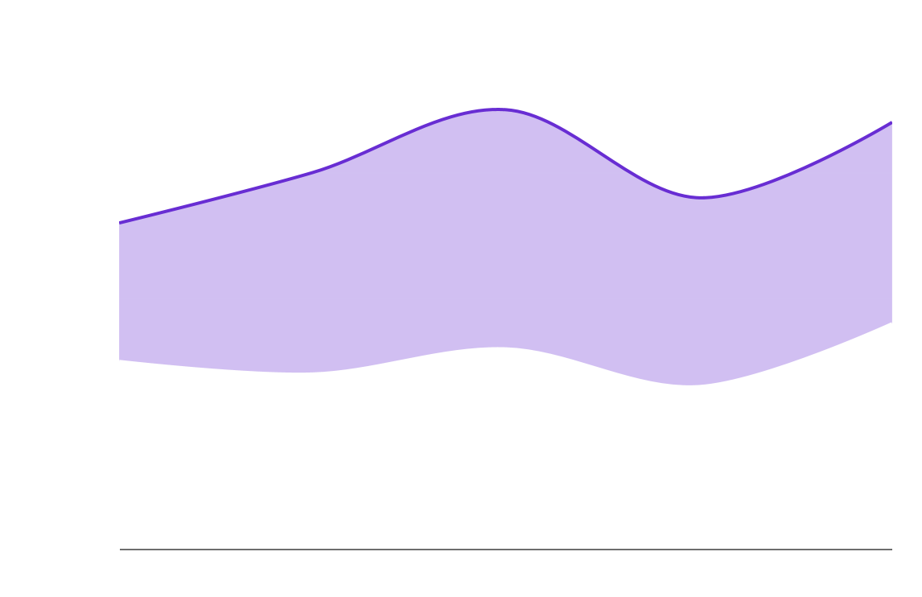
Tendency
Phase 1
Phase 2
Neptune is the farthest planet from the Sun
Saturn is a gas giant and has several rings
Follow the link in the graph to modify its data and then paste the new one here. For more info, click here

